Slide 1
Data Mining
Unit-4: Cluster Analysis
Dr.G.Padmavathi
Associate professor
CRRAO AIMSCS

Slide 2
Course Overview
Credits: 3 (L-T-P: 3-0-0)
Pre-requisites: Database Management Systems
Probability and Statistics
Goal: Introduce key data mining techniques & their applications

Slide 3
Data Mining Syllabus
UNIT - I
Introduction to Data Mining:
What Data mining? Kinds of Data, Knowledge Discovery process, Data Mining Functionalities, Kinds of Patterns, Major Issues in Data Mining. Data Objects and Attribute Types, Basic Statistical Descriptions of Data, Data Visualization, Measuring Data Similarity and Dissimilarity, Data Pre-processing: Major Tasks in Data Pre-processing, Data Cleaning, Data Integration, Data Reduction, Data Transformation and Data Discretization.
UNIT - II
Association Analysis: Basic Concepts, Market Basket Analysis, Apriori Algorithm, FP-growth, From Association Analysis to Correlation Analysis, Pattern Mining in Multilevel Associations and Multidimensional Associations.
UNIT - III
Classification: Basic Concepts, Decision Tree Induction, Bayes Classification Methods, Rule-Based Classification, Metrics for Evaluating Classifier Performance, Ensemble Methods, Multilayer Feed- Forward Neural Network, Support Vector Machines, k-Nearest-Neighbor Classifiers.
UNIT - IV
Cluster Analysis: Requirements for Cluster Analysis, Overview of Basic Clustering Methods, Partitioning Methods-k-Means, k-Medoids, Hierarchical Methods-AGENES, DIANA, BIRCH, Density- Based Method-DBSCAN, Outlier Analysis: Types of Outliers, Challenges of Outlier Detection, and Overview of Outlier Detection Methods
UNIT - V
Advanced Concepts: Web Mining- Web Content Mining, Web Structure Mining, Web Usage Mining, Spatial Mining- Spatial Data Overview, Spatial Data Mining Primitives, Spatial Rules, Spatial Classification Algorithm, Spatial Clustering Algorithms, Temporal Mining- Modeling Temporal Events, Time Series, Pattern Detection, Sequences, Temporal Association Rules.

Slide 4
TEXT BOOKS:
Jiawei Han, Micheline Kamber, Jian Pei., Data Mining: Concepts and Techniques, 3rd Edition, Morgan Kaufmann/Elsevier, 2012.
Margaret H Dunham, Data Mining Introductory and Advanced Topics, 2nd Edition, Pearson Education, India, 2006.
REFERENCE BOOKS:
Data Mining Techniques, Arun K Pujari, 3rd Edition, Universities Press.
Pang-Ning Tan, Michael Steinbach, Anuj Karpatne and Vipin Kumar, Introduction to Data Mining, 2nd Edition, Pearson Education India, 2021.
Amitesh Sinha, Data Warehousing, Thomson Learning, India, 2007.

Slide 5
Clustering Methods
Partitioning Methods
Hierarchical Methods
Density-Based Methods
Grid-Based Methods
Evaluation of Clustering

Slide 6
What is Cluster Analysis?
Cluster: A collection of data objects
  similar (or related) to one another within the same group
  dissimilar (or unrelated) to the objects in other groups
Cluster analysis (or clustering, data segmentation, …)
  Finding similarities between data according to the characteristics found in the data and grouping similar data objects into clusters
Unsupervised learning: no predefined classes (i.e., learning by observations vs. learning by examples: supervised)
Typical applications
  As a stand-alone tool to get insight into data distribution
  As a preprocessing step for other algorithms

Slide 7
Clustering for Data Understanding and Applications
Biology: taxonomy of living things: kingdom, phylum, class, order, family, genus and species
Information retrieval: document clustering
Land use: Identification of areas of similar land use in an earth observation database
Marketing: Help marketers discover distinct groups in their customer bases, and then use this knowledge to develop targeted marketing programs
City-planning: Identifying groups of houses according to their house type, value, and geographical location
Earth-quake studies: Observed earth quake epicenters should be clustered along continent faults
Climate: understanding earth climate, find patterns of atmospheric and ocean
Economic Science: market resarch

Slide 8
Clustering as a Preprocessing Tool (Utility)
Summarization:
  Preprocessing for regression, PCA, classification, and association analysis
Compression:
  Image processing: vector quantization
Finding K-nearest Neighbors
  Localizing search to one or a small number of clusters
Outlier detection
  Outliers are often viewed as those “far away” from any cluster

Slide 9
Quality: What Is Good Clustering?
A good clustering method will produce high quality clusters
  high intra-class similarity: cohesive within clusters
  low inter-class similarity: distinctive between clusters
The quality of a clustering method depends on
  the similarity measure used by the method
  its implementation, and
  Its ability to discover some or all of the hidden patterns

Slide 10
Measure the Quality of Clustering
Dissimilarity/Similarity metric
  Similarity is expressed in terms of a distance function, typically metric: d(i, j)
  The definitions of distance functions are usually rather different for interval-scaled, boolean, categorical, ordinal ratio, and vector variables
  Weights should be associated with different variables based on applications and data semantics
Quality of clustering:
  There is usually a separate “quality” function that measures the “goodness” of a cluster.
  It is hard to define “similar enough” or “good enough”
    The answer is typically highly subjective

Slide 11
Considerations for Cluster Analysis
Partitioning criteria
  Single level vs. hierarchical partitioning (often, multi-level hierarchical partitioning is desirable)
Separation of clusters
  Exclusive (e.g., one customer belongs to only one region) vs. non-exclusive (e.g., one document may belong to more than one class)
Similarity measure
  Distance-based (e.g., Euclidian, road network, vector) vs. connectivity-based (e.g., density or contiguity)
Clustering space
  Full space (often when low dimensional) vs. subspaces (often in high-dimensional clustering)

Slide 12
Requirements and Challenges
Scalability
  Clustering all the data instead of only on samples
Ability to deal with different types of attributes
  Numerical, binary, categorical, ordinal, linked, and mixture of these
Constraint-based clustering
    User may give inputs on constraints
    Use domain knowledge to determine input parameters
Interpretability and usability
Others
  Discovery of clusters with arbitrary shape
  Ability to deal with noisy data
  Incremental clustering and insensitivity to input order
  High dimensionality

Slide 13
Major Clustering Approaches (I)
Partitioning approach:
  Construct various partitions and then evaluate them by some criterion, e.g., minimizing the sum of square errors
  Typical methods: k-means, k-medoids, CLARANS
Hierarchical approach:
  Create a hierarchical decomposition of the set of data (or objects) using some criterion
  Typical methods: Diana, Agnes, BIRCH, CAMELEON
Density-based approach:
  Based on connectivity and density functions
  Typical methods: DBSACN, OPTICS, DenClue
Grid-based approach:
  based on a multiple-level granularity structure
  Typical methods: STING, WaveCluster, CLIQUE

Slide 14
Major Clustering Approaches (II)
Model-based:
  A model is hypothesized for each of the clusters and tries to find the best fit of that model to each other
  Typical methods: EM, SOM, COBWEB
Frequent pattern-based:
  Based on the analysis of frequent patterns
  Typical methods: p-Cluster
User-guided or constraint-based:
  Clustering by considering user-specified or application-specific constraints
  Typical methods: COD (obstacles), constrained clustering
Link-based clustering:
  Objects are often linked together in various ways
  Massive links can be used to cluster objects: SimRank, LinkClus

Slide 15
Cluster Analysis: Basic Concepts and Methods
Cluster Analysis: Basic Concepts
Partitioning Methods
Hierarchical Methods
Density-Based Methods
Grid-Based Methods
Evaluation of Clustering
Summary
15
15
Notes:
15

Slide 16
Partitioning Algorithms: Basic Concept
Partitioning method: Partitioning a database D of n objects into a set of k clusters, such that the sum of squared distances is minimized (where c_{i} is the centroid or medoid of cluster C_{i})
Given k, find a partition of k clusters that optimizes the chosen partitioning criterion
  Global optimal: exhaustively enumerate all partitions
  Heuristic methods: k-means and k-medoids algorithms
  k-means (MacQueen’67, Lloyd’57/’82): Each cluster is represented by the center of the cluster
  k-medoids or PAM (Partition around medoids) (Kaufman & Rousseeuw’87): Each cluster is represented by one of the objects in the cluster

Slide 17
The K-Means Clustering Method
Given k, the k-means algorithm is implemented in four steps:
  Partition objects into k nonempty subsets
  Compute seed points as the centroids of the clusters of the current partitioning (the centroid is the center, i.e., mean point, of the cluster)
  Assign each object to the cluster with the nearest seed point
  Go back to Step 2, stop when the assignment does not change

Slide 18
An Example of K-Means Clustering
K=2
Arbitrarily partition objects into k groups
Update the cluster centroids
The initial data set
Loop if needed
Reassign objects
Partition objects into k nonempty subsets
Repeat
  Compute centroid (i.e., mean point) for each partition
  Assign each object to the cluster of its nearest centroid
Until no change
Update the cluster centroids

Slide 19
Comments on the K-Means Method
Strength: Efficient: O(tkn), where n is # objects, k is # clusters, and t is # iterations. Normally, k, t << n.
    Comparing: PAM: O(k(n-k)² ), CLARA: O(ks² + k(n-k))
Comment: Often terminates at a local optimal.
Weakness
  Applicable only to objects in a continuous n-dimensional space
    Using the k-modes method for categorical data
    In comparison, k-medoids can be applied to a wide range of data
  Need to specify k, the number of clusters, in advance (there are ways to automatically determine the best k (see Hastie et al., 2009)
  Sensitive to noisy data and outliers
  Not suitable to discover clusters with non-convex shapes

Slide 20
Variations of the K-Means Method
Most of the variants of the k-means which differ in
  Selection of the initial k means
  Dissimilarity calculations
  Strategies to calculate cluster means
Handling categorical data: k-modes
  Replacing means of clusters with modes
  Using new dissimilarity measures to deal with categorical objects
  Using a frequency-based method to update modes of clusters
  A mixture of categorical and numerical data: k-prototype method

Slide 21
What Is the Problem of the K-Means Method?
The k-means algorithm is sensitive to outliers !
  Since an object with an extremely large value may substantially distort the distribution of the data
K-Medoids: Instead of taking the mean value of the object in a cluster as a reference point, medoids can be used, which is the most centrally located object in a cluster
10
10
9
9
8
8
7
7
6
6
5
5
4
4
3
3
2
2
1
1
0
0
1
2
3
4
5
6
7
8
9
10
0
0
1
2
3
4
5
6
7
8
9
10

Slide 22
PAM: A Typical K-Medoids Algorithm
Total Cost = 20
10
9
8
Arbitrary choose k object as initial medoids
Assign each remaining object to nearest medoids
7
6
5
4
3
2
1
0
0
1
2
3
4
5
6
7
8
9
10
K=2
Randomly select a nonmedoid object,O_{ramdom}
Total Cost = 26
Do loop
Until no change
10
10
9
Compute total cost of swapping
9
Swapping O and O_{ramdom}
If quality is improved.
8
8
7
7
6
6
5
5
4
4
3
3
2
2
1
1
0
0
1
2
3
4
5
6
7
8
9
10
0
0
1
2
3
4
5
6
7
8
9
10
22
Notes:
22

Slide 23
The K-Medoid Clustering Method
K-Medoids Clustering: Find representative objects (medoids) in clusters
  PAM (Partitioning Around Medoids, Kaufmann & Rousseeuw 1987)
    Starts from an initial set of medoids and iteratively replaces one of the medoids by one of the non-medoids if it improves the total distance of the resulting clustering
    PAM works effectively for small data sets, but does not scale well for large data sets (due to the computational complexity)
Efficiency improvement on PAM
  CLARA (Kaufmann & Rousseeuw, 1990): PAM on samples
  CLARANS (Ng & Han, 1994): Randomized re-sampling

Slide 24
Chapter 10. Cluster Analysis: Basic Concepts and Methods
Cluster Analysis: Basic Concepts
Partitioning Methods
Hierarchical Methods
Density-Based Methods
Grid-Based Methods
Evaluation of Clustering
Summary
24
24
Notes:
24

Slide 25
Hierarchical Clustering
Use distance matrix as clustering criteria. This method does not require the number of clusters k as an input, but needs a termination condition
Step 0
Step 1
Step 2
Step 3
Step 4
agglomerative
(AGNES)
a
a b
b
a b c d e
c
c d e
d
d e
e
divisive
(DIANA)
Step 4
Step 3
Step 2
Step 1
Step 0

Slide 26
AGNES (Agglomerative Nesting)
Introduced in Kaufmann and Rousseeuw (1990)
Implemented in statistical packages, e.g., Splus
Use the single-link method and the dissimilarity matrix
Merge nodes that have the least dissimilarity
Go on in a non-descending fashion
Eventually all nodes belong to the same cluster

Slide 27
Dendrogram: Shows How Clusters are Merged
  Decompose data objects into a several levels of nested partitioning (tree of clusters), called a dendrogram
  A clustering of the data objects is obtained by cutting the dendrogram at the desired level, then each connected component forms a cluster

Slide 28
DIANA (Divisive Analysis)
Introduced in Kaufmann and Rousseeuw (1990)
Implemented in statistical analysis packages, e.g., Splus
Inverse order of AGNES
Eventually each node forms a cluster on its own

Slide 29
Distance between Clusters
X
X
Single link: smallest distance between an element in one cluster and an element in the other, i.e., dist(K_{i}, K_{j}) = min(t_{ip}, t_{jq})
Complete link: largest distance between an element in one cluster and an element in the other, i.e., dist(K_{i}, K_{j}) = max(t_{ip}, t_{jq})
Average: avg distance between an element in one cluster and an element in the other, i.e., dist(K_{i}, K_{j}) = avg(t_{ip}, t_{jq})
Centroid: distance between the centroids of two clusters, i.e., dist(K_{i}, K_{j}) = dist(C_{i}, C_{j})
Medoid: distance between the medoids of two clusters, i.e., dist(K_{i}, K_{j}) = dist(M_{i}, M_{j})
  Medoid: a chosen, centrally located object in the cluster
29
Notes:
29

Slide 30
Centroid, Radius and Diameter of a Cluster (for numerical data sets)
Centroid: the “middle” of a cluster
Radius: square root of average distance from any point of the cluster to its centroid
Diameter: square root of average mean squared distance between all pairs of points in the cluster
30
Notes:
30

Slide 31
Extensions to Hierarchical Clustering
Major weakness of agglomerative clustering methods
  Can never undo what was done previously
  Do not scale well: time complexity of at least O(n²), where n is the number of total objects
Integration of hierarchical & distance-based clustering
  BIRCH (1996): uses CF-tree and incrementally adjusts the quality of sub-clusters
  CHAMELEON (1999): hierarchical clustering using dynamic modeling

Slide 32
BIRCH (Balanced Iterative Reducing and Clustering Using Hierarchies)
Zhang, Ramakrishnan & Livny, SIGMOD’96
Incrementally construct a CF (Clustering Feature) tree, a hierarchical data structure for multiphase clustering
  Phase 1: scan DB to build an initial in-memory CF tree (a multi-level compression of the data that tries to preserve the inherent clustering structure of the data)
  Phase 2: use an arbitrary clustering algorithm to cluster the leaf nodes of the CF-tree
Scales linearly: finds a good clustering with a single scan and improves the quality with a few additional scans
Weakness: handles only numeric data, and sensitive to the order of the data record

Slide 33
Clustering Feature Vector in BIRCH
Clustering Feature (CF): CF = (N, LS, SS)
N: Number of data points
LS: linear sum of N points:
SS: square sum of N points
CF = (5, (16,30),(54,190))
(3,4)
(2,6)
(4,5)
(4,7)
(3,8)

Slide 34
CF-Tree in BIRCH
Clustering feature:
  Summary of the statistics for a given subcluster: the 0-th, 1st, and 2nd moments of the subcluster from the statistical point of view
  Registers crucial measurements for computing cluster and utilizes storage efficiently
A CF tree is a height-balanced tree that stores the clustering features for a hierarchical clustering
  A nonleaf node in a tree has descendants or “children”
  The nonleaf nodes store sums of the CFs of their children
A CF tree has two parameters
  Branching factor: max # of children
  Threshold: max diameter of sub-clusters stored at the leaf nodes

Slide 35
The CF Tree Structure
Root
B = 7
L = 6
CF₁
CF₂
CF₃
CF₆
child₁
child₂
child₃
child₆
Non-leaf node
CF₁
CF₂
CF₃
CF₅
child₁
child₂
child₃
child₅
Leaf node
Leaf node
prev
CF₁
CF₂
CF₆
next
prev
CF₁
CF₂
CF₄
next

Slide 36
The Birch Algorithm
Cluster Diameter
For each point in the input
  Find closest leaf entry
  Add point to leaf entry and update CF
  If entry diameter > max_diameter, then split leaf, and possibly parents
Algorithm is O(n)
Concerns
  Sensitive to insertion order of data points
  Since we fix the size of leaf nodes, so clusters may not be so natural
  Clusters tend to be spherical given the radius and diameter measures

Slide 37
CHAMELEON: Hierarchical Clustering Using Dynamic Modeling (1999)
CHAMELEON: G. Karypis, E. H. Han, and V. Kumar, 1999
Measures the similarity based on a dynamic model
  Two clusters are merged only if the interconnectivity and closeness (proximity) between two clusters are high relative to the internal interconnectivity of the clusters and closeness of items within the clusters
Graph-based, and a two-phase algorithm
  Use a graph-partitioning algorithm: cluster objects into a large number of relatively small sub-clusters
  Use an agglomerative hierarchical clustering algorithm: find the genuine clusters by repeatedly combining these sub-clusters

Slide 38
Overall Framework of CHAMELEON
Construct (K-NN)
Sparse Graph
Partition the Graph
Data Set
K-NN Graph
  P and q are connected if q is among the top k closest neighbors of p
Merge Partition
Relative interconnectivity: connectivity of c₁ and c₂ over internal connectivity
Relative closeness: closeness of c₁ and c₂ over internal closeness
Final Clusters

Slide 39
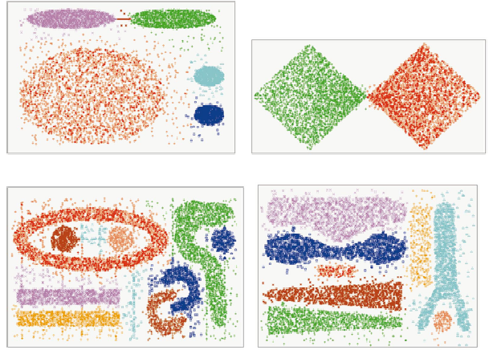
CHAMELEON (Clustering Complex Objects)

Slide 40
Probabilistic Hierarchical Clustering
Algorithmic hierarchical clustering
  Nontrivial to choose a good distance measure
  Hard to handle missing attribute values
  Optimization goal not clear: heuristic, local search
Probabilistic hierarchical clustering
  Use probabilistic models to measure distances between clusters
  Generative model: Regard the set of data objects to be clustered as a sample of the underlying data generation mechanism to be analyzed
  Easy to understand, same efficiency as algorithmic agglomerative clustering method, can handle partially observed data
In practice, assume the generative models adopt common distributions functions, e.g., Gaussian distribution or Bernoulli distribution, governed by parameters
40

Slide 41

Generative Model
Given a set of 1-D points X = {x₁, …, x_{n}} for clustering analysis & assuming they are generated by a Gaussian distribution:
The probability that a point x_{i} ∈ X is generated by the model
The likelihood that X is generated by the model:
The task of learning the generative model: find the parameters μ and σ² such that
the maximum likelihood
41

Slide 42

A Probabilistic Hierarchical Clustering Algorithm
For a set of objects partitioned into m clusters C₁, . . . ,C_{m}, the quality can be measured by,
  where P() is the maximum likelihood
Distance between clusters C₁ and C₂:
Algorithm: Progressively merge points and clusters
  Input: D = {o₁, ..., o_{n}}: a data set containing n objects
  Output: A hierarchy of clusters
  Method
    Create a cluster for each object C_{i} = {o_{i}}, 1 ≤ i ≤ n;
    For i = 1 to n {
      Find pair of clusters C_{i} and C_{j} such that
        C_{i},C_{j} = argmax_{i ≠ j} {log (P(C_{i}∪C_{j} )/(P(C_{i})P(C_{j} ))};
      If log (P(C_{i}∪C_{j} )/(P(C_{i})P(C_{j} )) > 0 then merge C_{i} and C_{j} }
42

Slide 43
Chapter 10. Cluster Analysis: Basic Concepts and Methods
Cluster Analysis: Basic Concepts
Partitioning Methods
Hierarchical Methods
Density-Based Methods
Grid-Based Methods
Evaluation of Clustering
Summary
43
43
Notes:
43

Slide 44
Density-Based Clustering Methods
Clustering based on density (local cluster criterion), such as density-connected points
Major features:
  Discover clusters of arbitrary shape
  Handle noise
  One scan
  Need density parameters as termination condition
Several interesting studies:
  DBSCAN: Ester, et al. (KDD’96)
  OPTICS: Ankerst, et al (SIGMOD’99).
  DENCLUE: Hinneburg & D. Keim (KDD’98)
  CLIQUE: Agrawal, et al. (SIGMOD’98) (more grid-based)

Slide 45
Density-Based Clustering: Basic Concepts
Two parameters:
  Eps: Maximum radius of the neighbourhood
  MinPts: Minimum number of points in an Eps-neighbourhood of that point
N_{Eps}(p): {q belongs to D | dist(p,q) ≤ Eps}
Directly density-reachable: A point p is directly density-reachable from a point q w.r.t. Eps, MinPts if
  p belongs to N_{Eps}(q)
  core point condition:
  |N_{Eps} (q)| ≥ MinPts
p
MinPts = 5
Eps = 1 cm
q

Slide 46
Density-Reachable and Density-Connected
Density-reachable:
  A point p is density-reachable from a point q w.r.t. Eps, MinPts if there is a chain of points p₁, …, p_{n}, p₁ = q, p_{n} = p such that p_{i+1} is directly density-reachable from p_{i}
Density-connected
  A point p is density-connected to a point q w.r.t. Eps, MinPts if there is a point o such that both, p and q are density-reachable from o w.r.t. Eps and MinPts
p
p₁
q
p
q
o

Slide 47
DBSCAN: Density-Based Spatial Clustering of Applications with Noise
Relies on a density-based notion of cluster: A cluster is defined as a maximal set of density-connected points
Discovers clusters of arbitrary shape in spatial databases with noise
Outlier
Border
Eps = 1cm
MinPts = 5
Core

Slide 48
DBSCAN: The Algorithm
Arbitrary select a point p
Retrieve all points density-reachable from p w.r.t. Eps and MinPts
If p is a core point, a cluster is formed
If p is a border point, no points are density-reachable from p and DBSCAN visits the next point of the database
Continue the process until all of the points have been processed

Slide 49
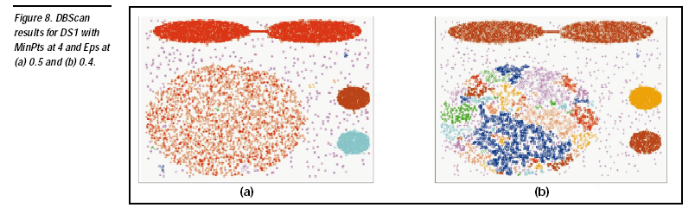

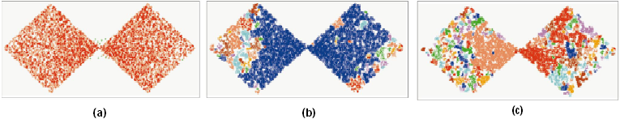
DBSCAN: Sensitive to Parameters

Slide 50
OPTICS: A Cluster-Ordering Method (1999)
OPTICS: Ordering Points To Identify the Clustering Structure
  Ankerst, Breunig, Kriegel, and Sander (SIGMOD’99)
  Produces a special order of the database wrt its density-based clustering structure
  This cluster-ordering contains info equiv to the density-based clusterings corresponding to a broad range of parameter settings
  Good for both automatic and interactive cluster analysis, including finding intrinsic clustering structure
  Can be represented graphically or using visualization techniques

Slide 51
OPTICS: Some Extension from DBSCAN
Index-based:
    k = number of dimensions
    N = 20
    p = 75%
    M = N(1-p) = 5
  Complexity: O(NlogN)
Core Distance:
  min eps s.t. point is core
Reachability Distance
D
p1
o
p2
o
Max (core-distance (o), d (o, p))
r(p1, o) = 2.8cm. r(p2,o) = 4cm
MinPts = 5
ε = 3 cm

Slide 52
Reachability-distance
undefined
‘
Cluster-order
of the objects

Slide 53
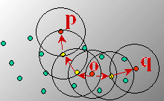
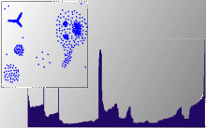
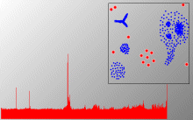
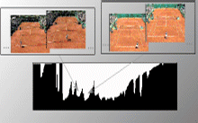
Density-Based Clustering: OPTICS & Its Applications

Slide 54
DENCLUE: Using Statistical Density Functions
DENsity-based CLUstEring by Hinneburg & Keim (KDD’98)
Using statistical density functions:
Major features
  Solid mathematical foundation
  Good for data sets with large amounts of noise
  Allows a compact mathematical description of arbitrarily shaped clusters in high-dimensional data sets
  Significant faster than existing algorithm (e.g., DBSCAN)
  But needs a large number of parameters
total influence on x
influence of y on x
gradient of x in the direction of x_{i}

Slide 55
Denclue: Technical Essence
Uses grid cells but only keeps information about grid cells that do actually contain data points and manages these cells in a tree-based access structure
Influence function: describes the impact of a data point within its neighborhood
Overall density of the data space can be calculated as the sum of the influence function of all data points
Clusters can be determined mathematically by identifying density attractors
Density attractors are local maximal of the overall density function
Center defined clusters: assign to each density attractor the points density attracted to it
Arbitrary shaped cluster: merge density attractors that are connected through paths of high density (> threshold)

Slide 56
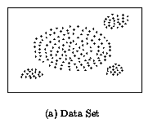
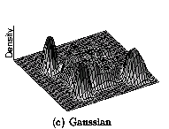
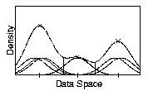
Density Attractor

Slide 57
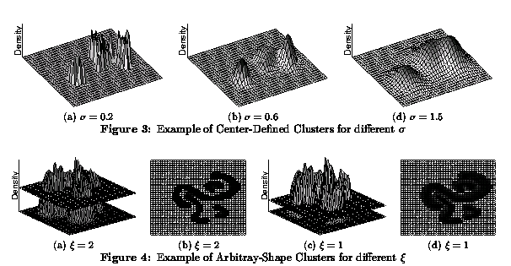
Center-Defined and Arbitrary

Slide 58
Chapter 10. Cluster Analysis: Basic Concepts and Methods
Cluster Analysis: Basic Concepts
Partitioning Methods
Hierarchical Methods
Density-Based Methods
Grid-Based Methods
Evaluation of Clustering
Summary
58
58
Notes:
58

Slide 59
Grid-Based Clustering Method
Using multi-resolution grid data structure
Several interesting methods
  STING (a STatistical INformation Grid approach) by Wang, Yang and Muntz (1997)
  WaveCluster by Sheikholeslami, Chatterjee, and Zhang (VLDB’98)
    A multi-resolution clustering approach using wavelet method
  CLIQUE: Agrawal, et al. (SIGMOD’98)
    Both grid-based and subspace clustering

Slide 60
STING: A Statistical Information Grid Approach
Wang, Yang and Muntz (VLDB’97)
The spatial area is divided into rectangular cells
There are several levels of cells corresponding to different levels of resolution

Slide 61
The STING Clustering Method
Each cell at a high level is partitioned into a number of smaller cells in the next lower level
Statistical info of each cell is calculated and stored beforehand and is used to answer queries
Parameters of higher level cells can be easily calculated from parameters of lower level cell
  count, mean, s, min, max
  type of distribution—normal, uniform, etc.
Use a top-down approach to answer spatial data queries
Start from a pre-selected layer—typically with a small number of cells
For each cell in the current level compute the confidence interval

Slide 62
STING Algorithm and Its Analysis
Remove the irrelevant cells from further consideration
When finish examining the current layer, proceed to the next lower level
Repeat this process until the bottom layer is reached
Advantages:
  Query-independent, easy to parallelize, incremental update
  O(K), where K is the number of grid cells at the lowest level
Disadvantages:
  All the cluster boundaries are either horizontal or vertical, and no diagonal boundary is detected

Slide 63
CLIQUE (Clustering In QUEst)
Agrawal, Gehrke, Gunopulos, Raghavan (SIGMOD’98)
Automatically identifying subspaces of a high dimensional data space that allow better clustering than original space
CLIQUE can be considered as both density-based and grid-based
  It partitions each dimension into the same number of equal length interval
  It partitions an m-dimensional data space into non-overlapping rectangular units
  A unit is dense if the fraction of total data points contained in the unit exceeds the input model parameter
  A cluster is a maximal set of connected dense units within a subspace
63
Notes:
63

Slide 64
CLIQUE: The Major Steps
Partition the data space and find the number of points that lie inside each cell of the partition.
Identify the subspaces that contain clusters using the Apriori principle
Identify clusters
  Determine dense units in all subspaces of interests
  Determine connected dense units in all subspaces of interests.
Generate minimal description for the clusters
  Determine maximal regions that cover a cluster of connected dense units for each cluster
  Determination of minimal cover for each cluster
64
Notes:
64

Slide 65
Salary (10,000)
Vacation(week)
7
7
6
6
5
5
4
4
3
3
2
2
1
1
0
age
0
age
20
30
40
50
60
20
30
40
50
60
τ = 3
Vacation
Salary
30
50
age
65
Notes:
65

Slide 66
Strength and Weakness of CLIQUE
Strength
  automatically finds subspaces of the highest dimensionality such that high density clusters exist in those subspaces
  insensitive to the order of records in input and does not presume some canonical data distribution
  scales linearly with the size of input and has good scalability as the number of dimensions in the data increases
Weakness
  The accuracy of the clustering result may be degraded at the expense of simplicity of the method
66
Notes:
66

Slide 67
Chapter 10. Cluster Analysis: Basic Concepts and Methods
Cluster Analysis: Basic Concepts
Partitioning Methods
Hierarchical Methods
Density-Based Methods
Grid-Based Methods
Evaluation of Clustering
Summary
67
67
Notes:
67

Slide 68
Assessing Clustering Tendency
68
Assess if non-random structure exists in the data by measuring the probability that the data is generated by a uniform data distribution
Test spatial randomness by statistic test: Hopkins Static
  Given a dataset D regarded as a sample of a random variable o, determine how far away o is from being uniformly distributed in the data space
  Sample n points, p₁, …, p_{n}, uniformly from D. For each p_{i}, find its nearest neighbor in D: x_{i} = min{dist (p_{i}, v)} where v in D
  Sample n points, q₁, …, q_{n}, uniformly from D. For each q_{i}, find its nearest neighbor in D – {q_{i}}: y_{i} = min{dist (q_{i}, v)} where v in D and v ≠ q_{i}
  Calculate the Hopkins Statistic:
  If D is uniformly distributed, ∑ x_{i} and ∑ y_{i} will be close to each other and H is close to 0.5. If D is highly skewed, H is close to 0

Slide 69
Determine the Number of Clusters
Empirical method
  # of clusters ≈√n/2 for a dataset of n points
Elbow method
  Use the turning point in the curve of sum of within cluster variance w.r.t the # of clusters
Cross validation method
  Divide a given data set into m parts
  Use m – 1 parts to obtain a clustering model
  Use the remaining part to test the quality of the clustering
    E.g., For each point in the test set, find the closest centroid, and use the sum of squared distance between all points in the test set and the closest centroids to measure how well the model fits the test set
  For any k > 0, repeat it m times, compare the overall quality measure w.r.t. different k’s, and find # of clusters that fits the data the best
69

Slide 70
Measuring Clustering Quality
Two methods: extrinsic vs. intrinsic
Extrinsic: supervised, i.e., the ground truth is available
  Compare a clustering against the ground truth using certain clustering quality measure
  Ex. BCubed precision and recall metrics
Intrinsic: unsupervised, i.e., the ground truth is unavailable
  Evaluate the goodness of a clustering by considering how well the clusters are separated, and how compact the clusters are
  Ex. Silhouette coefficient
70

Slide 71
Measuring Clustering Quality: Extrinsic Methods
71
Clustering quality measure: Q(C, C_{g}), for a clustering C given the ground truth C_{g}.
Q is good if it satisfies the following 4 essential criteria
  Cluster homogeneity: the purer, the better
  Cluster completeness: should assign objects belong to the same category in the ground truth to the same cluster
  Rag bag: putting a heterogeneous object into a pure cluster should be penalized more than putting it into a rag bag (i.e., “miscellaneous” or “other” category)
  Small cluster preservation: splitting a small category into pieces is more harmful than splitting a large category into pieces

Slide 72
Chapter 10. Cluster Analysis: Basic Concepts and Methods
Cluster Analysis: Basic Concepts
Partitioning Methods
Hierarchical Methods
Density-Based Methods
Grid-Based Methods
Evaluation of Clustering
Summary
72
72
Notes:
72

Slide 73
Summary
Cluster analysis groups objects based on their similarity and has wide applications
Measure of similarity can be computed for various types of data
Clustering algorithms can be categorized into partitioning methods, hierarchical methods, density-based methods, grid-based methods, and model-based methods
K-means and K-medoids algorithms are popular partitioning-based clustering algorithms
Birch and Chameleon are interesting hierarchical clustering algorithms, and there are also probabilistic hierarchical clustering algorithms
DBSCAN, OPTICS, and DENCLU are interesting density-based algorithms
STING and CLIQUE are grid-based methods, where CLIQUE is also a subspace clustering algorithm
Quality of clustering results can be evaluated in various ways

Slide 74
CS512-Spring 2011: An Introduction
Coverage
  Cluster Analysis: Chapter 11
  Outlier Detection: Chapter 12
  Mining Sequence Data: BK2: Chapter 8
  Mining Graphs Data: BK2: Chapter 9
  Social and Information Network Analysis
    BK2: Chapter 9
    Partial coverage: Mark Newman: “Networks: An Introduction”, Oxford U., 2010
    Scattered coverage: Easley and Kleinberg, “Networks, Crowds, and Markets: Reasoning About a Highly Connected World”, Cambridge U., 2010
    Recent research papers
  Mining Data Streams: BK2: Chapter 8
Requirements
  One research project
  One class presentation (15 minutes)
  Two homeworks (no programming assignment)
  Two midterm exams (no final exam)
74
Notes:
74
74

Slide 75
References (1)
R. Agrawal, J. Gehrke, D. Gunopulos, and P. Raghavan. Automatic subspace clustering of high dimensional data for data mining applications. SIGMOD'98
M. R. Anderberg. Cluster Analysis for Applications. Academic Press, 1973.
M. Ankerst, M. Breunig, H.-P. Kriegel, and J. Sander. Optics: Ordering points to identify the clustering structure, SIGMOD’99.
Beil F., Ester M., Xu X.: "Frequent Term-Based Text Clustering", KDD'02
M. M. Breunig, H.-P. Kriegel, R. Ng, J. Sander. LOF: Identifying Density-Based Local Outliers. SIGMOD 2000.
M. Ester, H.-P. Kriegel, J. Sander, and X. Xu. A density-based algorithm for discovering clusters in large spatial databases. KDD'96.
M. Ester, H.-P. Kriegel, and X. Xu. Knowledge discovery in large spatial databases: Focusing techniques for efficient class identification. SSD'95.
D. Fisher. Knowledge acquisition via incremental conceptual clustering. Machine Learning, 2:139-172, 1987.
D. Gibson, J. Kleinberg, and P. Raghavan. Clustering categorical data: An approach based on dynamic systems. VLDB’98.
V. Ganti, J. Gehrke, R. Ramakrishan. CACTUS Clustering Categorical Data Using Summaries. KDD'99.

Slide 76
References (2)
D. Gibson, J. Kleinberg, and P. Raghavan. Clustering categorical data: An approach based on dynamic systems. In Proc. VLDB’98.
S. Guha, R. Rastogi, and K. Shim. Cure: An efficient clustering algorithm for large databases. SIGMOD'98.
S. Guha, R. Rastogi, and K. Shim. ROCK: A robust clustering algorithm for categorical attributes. In ICDE'99, pp. 512-521, Sydney, Australia, March 1999.
A. Hinneburg, D.l A. Keim: An Efficient Approach to Clustering in Large Multimedia Databases with Noise. KDD’98.
A. K. Jain and R. C. Dubes. Algorithms for Clustering Data. Printice Hall, 1988.
G. Karypis, E.-H. Han, and V. Kumar. CHAMELEON: A Hierarchical Clustering Algorithm Using Dynamic Modeling. COMPUTER, 32(8): 68-75, 1999.
L. Kaufman and P. J. Rousseeuw. Finding Groups in Data: an Introduction to Cluster Analysis. John Wiley & Sons, 1990.
E. Knorr and R. Ng. Algorithms for mining distance-based outliers in large datasets. VLDB’98.

Slide 77
References (3)
G. J. McLachlan and K.E. Bkasford. Mixture Models: Inference and Applications to Clustering. John Wiley and Sons, 1988.
R. Ng and J. Han. Efficient and effective clustering method for spatial data mining. VLDB'94.
L. Parsons, E. Haque and H. Liu, Subspace Clustering for High Dimensional Data: A Review, SIGKDD Explorations, 6(1), June 2004
E. Schikuta. Grid clustering: An efficient hierarchical clustering method for very large data sets. Proc. 1996 Int. Conf. on Pattern Recognition
G. Sheikholeslami, S. Chatterjee, and A. Zhang. WaveCluster: A multi-resolution clustering approach for very large spatial databases. VLDB’98.
A. K. H. Tung, J. Han, L. V. S. Lakshmanan, and R. T. Ng. Constraint-Based Clustering in Large Databases, ICDT'01.
A. K. H. Tung, J. Hou, and J. Han. Spatial Clustering in the Presence of Obstacles, ICDE'01
H. Wang, W. Wang, J. Yang, and P.S. Yu. Clustering by pattern similarity in large data sets, SIGMOD’02
W. Wang, Yang, R. Muntz, STING: A Statistical Information grid Approach to Spatial Data Mining, VLDB’97
T. Zhang, R. Ramakrishnan, and M. Livny. BIRCH : An efficient data clustering method for very large databases. SIGMOD'96
X. Yin, J. Han, and P. S. Yu, “LinkClus: Efficient Clustering via Heterogeneous Semantic Links”, VLDB'06

Slide 78
Slides unused in class

Slide 79
A Typical K-Medoids Algorithm (PAM)
Total Cost = 20
10
9
8
Arbitrary choose k object as initial medoids
Assign each remaining object to nearest medoids
7
6
5
4
3
2
1
0
0
1
2
3
4
5
6
7
8
9
10
K=2
Randomly select a nonmedoid object,O_{ramdom}
Total Cost = 26
Do loop
Until no change
10
10
9
Compute total cost of swapping
9
Swapping O and O_{ramdom}
If quality is improved.
8
8
7
7
6
6
5
5
4
4
3
3
2
2
1
1
0
0
1
2
3
4
5
6
7
8
9
10
0
0
1
2
3
4
5
6
7
8
9
10

Slide 80
PAM (Partitioning Around Medoids) (1987)
PAM (Kaufman and Rousseeuw, 1987), built in Splus
Use real object to represent the cluster
  Select k representative objects arbitrarily
  For each pair of non-selected object h and selected object i, calculate the total swapping cost TC_{ih}
  For each pair of i and h,
    If TC_{ih} < 0, i is replaced by h
    Then assign each non-selected object to the most similar representative object
  repeat steps 2-3 until there is no change

Slide 81
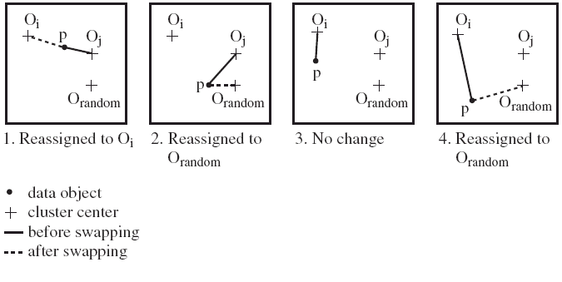
PAM Clustering: Finding the Best Cluster Center
Case 1: p currently belongs to o_{j}. If o_{j} is replaced by o_{random} as a representative object and p is the closest to one of the other representative object o_{i}, then p is reassigned to o_{i}

Slide 82
What Is the Problem with PAM?
Pam is more robust than k-means in the presence of noise and outliers because a medoid is less influenced by outliers or other extreme values than a mean
Pam works efficiently for small data sets but does not scale well for large data sets.
  O(k(n-k)² ) for each iteration
where n is # of data,k is # of clusters
Sampling-based method
CLARA(Clustering LARge Applications)

Slide 83
CLARA (Clustering Large Applications) (1990)
CLARA (Kaufmann and Rousseeuw in 1990)
  Built in statistical analysis packages, such as SPlus
  It draws multiple samples of the data set, applies PAM on each sample, and gives the best clustering as the output
Strength: deals with larger data sets than PAM
Weakness:
  Efficiency depends on the sample size
  A good clustering based on samples will not necessarily represent a good clustering of the whole data set if the sample is biased

Slide 84
CLARANS (“Randomized” CLARA) (1994)
CLARANS (A Clustering Algorithm based on Randomized Search) (Ng and Han’94)
  Draws sample of neighbors dynamically
  The clustering process can be presented as searching a graph where every node is a potential solution, that is, a set of k medoids
  If the local optimum is found, it starts with new randomly selected node in search for a new local optimum
Advantages: More efficient and scalable than both PAM and CLARA
Further improvement: Focusing techniques and spatial access structures (Ester et al.’95)

Slide 85
ROCK: Clustering Categorical Data
ROCK: RObust Clustering using linKs
  S. Guha, R. Rastogi & K. Shim, ICDE’99
Major ideas
  Use links to measure similarity/proximity
  Not distance-based
Algorithm: sampling-based clustering
  Draw random sample
  Cluster with links
  Label data in disk
Experiments
  Congressional voting, mushroom data

Slide 86
Similarity Measure in ROCK
Traditional measures for categorical data may not work well, e.g., Jaccard coefficient
Example: Two groups (clusters) of transactions
  C₁. <a, b, c, d, e>: {a, b, c}, {a, b, d}, {a, b, e}, {a, c, d}, {a, c, e}, {a, d, e}, {b, c, d}, {b, c, e}, {b, d, e}, {c, d, e}
  C₂. <a, b, f, g>: {a, b, f}, {a, b, g}, {a, f, g}, {b, f, g}
Jaccard co-efficient may lead to wrong clustering result
  C₁: 0.2 ({a, b, c}, {b, d, e}} to 0.5 ({a, b, c}, {a, b, d})
  C₁ & C₂: could be as high as 0.5 ({a, b, c}, {a, b, f})
Jaccard co-efficient-based similarity function:
  Ex. Let T₁ = {a, b, c}, T₂ = {c, d, e}

Slide 87
Link Measure in ROCK
Clusters
  C₁:<a, b, c, d, e>: {a, b, c}, {a, b, d}, {a, b, e}, {a, c, d}, {a, c, e}, {a, d, e}, {b, c, d}, {b, c, e}, {b, d, e}, {c, d, e}
  C₂: <a, b, f, g>: {a, b, f}, {a, b, g}, {a, f, g}, {b, f, g}
Neighbors
  Two transactions are neighbors if sim(T₁,T₂) > threshold
  Let T₁ = {a, b, c}, T₂ = {c, d, e}, T₃ = {a, b, f}
    T₁ connected to: {a,b,d}, {a,b,e}, {a,c,d}, {a,c,e}, {b,c,d}, {b,c,e}, {a,b,f}, {a,b,g}
    T₂ connected to: {a,c,d}, {a,c,e}, {a,d,e}, {b,c,e}, {b,d,e}, {b,c,d}
    T₃ connected to: {a,b,c}, {a,b,d}, {a,b,e}, {a,b,g}, {a,f,g}, {b,f,g}
Link Similarity
  Link similarity between two transactions is the # of common neighbors
  link(T_{1,} T₂) = 4, since they have 4 common neighbors
    {a, c, d}, {a, c, e}, {b, c, d}, {b, c, e}
  link(T_{1,} T₃) = 3, since they have 3 common neighbors
    {a, b, d}, {a, b, e}, {a, b, g}

Slide 88
Rock Algorithm
Method
  Compute similarity matrix
    Use link similarity
  Run agglomerative hierarchical clustering
  When the data set is big
    Get sample of transactions
    Cluster sample
Problems:
  Guarantee cluster interconnectivity
    any two transactions in a cluster are very well connected
  Ignores information about closeness of two clusters
    two separate clusters may still be quite connected

Slide 89
Aggregation-Based Similarity Computation
0.2
ST₂
4
5
0.9
1.0
0.8
0.9
1.0
10
11
12
13
14
ST₁
a
b
For each node n_{k} ∈ {n₁₀, n₁₁, n₁₂} and n_{l} ∈ {n₁₃, n₁₄}, their path-based similarity sim_{p}(n_{k}, n_{l}) = s(n_{k}, n₄)·s(n₄, n₅)·s(n₅, n_{l}).
takes O(3+2) time
After aggregation, we reduce quadratic time computation to linear time computation.
Notes:
89

Slide 90
Computing Similarity with Aggregation
Average similarity
and total weight
a:(0.9,3)
b:(0.95,2)
0.2
4
5
sim(n_{a}, n_{b}) can be computed from aggregated similarities
10
11
12
13
14
a
b
sim(n_{a}, n_{b}) = avg_sim(n_{a},n₄) x s(n₄, n₅) x avg_sim(n_{b},n₅)
= 0.9 x 0.2 x 0.95 = 0.171
To compute sim(n_{a},n_{b}):
Find all pairs of sibling nodes n_{i} and n_{j}, so that n_{a} linked with n_{i} and n_{b} with n_{j}.
Calculate similarity (and weight) between n_{a} and n_{b} w.r.t. n_{i} and n_{j}.
Calculate weighted average similarity between n_{a} and n_{b} w.r.t. all such pairs.
Notes:
90

Slide 91
Chapter 10. Cluster Analysis: Basic Concepts and Methods
Cluster Analysis: Basic Concepts
Overview of Clustering Methods
Partitioning Methods
Hierarchical Methods
Density-Based Methods
Grid-Based Methods
Summary
91
91
Notes:
91

Slide 92
Link-Based Clustering: Calculate Similarities Based On Links
Authors
Proceedings
Conferences
The similarity between two objects x and y is defined as the average similarity between objects linked with x and those with y:
Issue: Expensive to compute:
  For a dataset of N objects and M links, it takes O(N²) space and O(M²) time to compute all similarities.
Tom
sigmod03
sigmod04
sigmod
Mike
sigmod05
vldb03
Cathy
vldb04
vldb
John
vldb05
aaai04
aaai
Mary
aaai05
Jeh & Widom, KDD’2002: SimRank
Two objects are similar if they are linked with the same or similar objects
92
Notes:
92

Slide 93
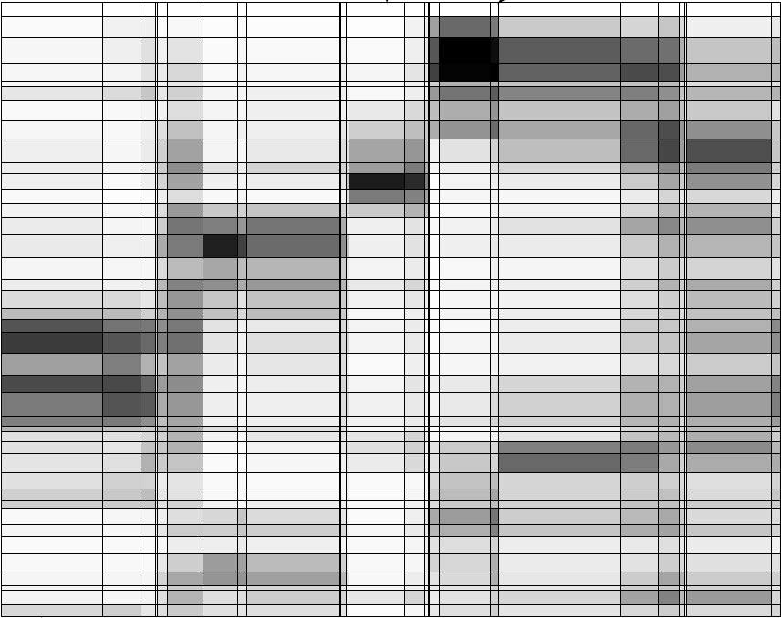
Observation 1: Hierarchical Structures
Hierarchical structures often exist naturally among objects (e.g., taxonomy of animals)
Relationships between articles and words (Chakrabarti, Papadimitriou, Modha, Faloutsos, 2004)
A hierarchical structure of products in Walmart
All
grocery
electronics
apparel
Articles
TV
DVD
camera
Words
93
Notes:
93

Slide 94
Observation 2: Distribution of Similarity
Distribution of SimRank similarities among DBLP authors
Power law distribution exists in similarities
  56% of similarity entries are in [0.005, 0.015]
  1.4% of similarity entries are larger than 0.1
  Can we design a data structure that stores the significant similarities and compresses insignificant ones?
94
Notes:
94

Slide 95
A Novel Data Structure: SimTree
Each leaf node represents an object
Each non-leaf node represents a group of similar lower-level nodes
Similarities between siblings are stored
Canon A40 digital camera
Digital Cameras
Sony V3 digital camera
Consumer electronics
Apparels
TVs
95
Notes:
95

Slide 96
Similarity Defined by SimTree
Similarity between two sibling nodes n₁ and n₂
n₁
0.2
n₂
n₃
Adjustment ratio for node n₇
0.8
0.9
0.9
n₄
0.3
n₅
n₆
0.9
0.8
1.0
n₇
n₈
n₉
Path-based node similarity
  sim_{p}(n₇,n₈) = s(n₇, n₄) x s(n₄, n₅) x s(n₅, n₈)
Similarity between two nodes is the average similarity between objects linked with them in other SimTrees
Adjust/ ratio for x =
Average similarity between x and all other nodes
Average similarity between x’s parent and all other nodes
96
Notes:
96

Slide 97
LinkClus: Efficient Clustering via Heterogeneous Semantic Links
Method
Initialize a SimTree for objects of each type
Repeat until stable
  For each SimTree, update the similarities between its nodes using similarities in other SimTrees
    Similarity between two nodes x and y is the average similarity between objects linked with them
  Adjust the structure of each SimTree
    Assign each node to the parent node that it is most similar to
For details: X. Yin, J. Han, and P. S. Yu, “LinkClus: Efficient Clustering via Heterogeneous Semantic Links”, VLDB'06
97
Notes:
97

Slide 98
Initialization of SimTrees
Initializing a SimTree
  Repeatedly find groups of tightly related nodes, which are merged into a higher-level node
Tightness of a group of nodes
  For a group of nodes {n₁, …, n_{k}}, its tightness is defined as the number of leaf nodes in other SimTrees that are connected to all of {n₁, …, n_{k}}
Nodes
Leaf nodes in another SimTree
n₁
1
2
The tightness of {n₁, n₂} is 3
3
n₂
4
5
98
Notes:
98
We use this simple definition of tightness for efficiency concerns.

Slide 99
Finding Tight Groups by Freq. Pattern Mining
Finding tight groups Frequent pattern mining
Procedure of initializing a tree
  Start from leaf nodes (level-0)
  At each level l, find non-overlapping groups of similar nodes with frequent pattern mining
Reduced to
Transactions
1
{n1}
The tightness of a group of nodes is the support of a frequent pattern
g₁
n₁
{n1, n2}
2
{n2}
n₂
3
{n1, n2}
4
{n1, n2}
5
{n2, n3, n4}
n₃
6
g₂
{n4}
7
{n3, n4}
n₄
8
{n3, n4}
9
99
Notes:
99

Slide 100
Adjusting SimTree Structures
n₁
n₂
n₃
0.9
0.8
n₄
n₅
n₆
n₇
n₇
n₈
n₉
After similarity changes, the tree structure also needs to be changed
  If a node is more similar to its parent’s sibling, then move it to be a child of that sibling
  Try to move each node to its parent’s sibling that it is most similar to, under the constraint that each parent node can have at most c children
100
Notes:
100

Slide 101
Complexity
For two types of objects, N in each, and M linkages between them.
 | Time | Space
Updating similarities | O(M(logN)²) | O(M+N)
Adjusting tree structures | O(N) | O(N)
LinkClus | O(M(logN)²) | O(M+N)
SimRank | O(M²) | O(N²)
101
Notes:
101

Slide 102
Experiment: Email Dataset
F. Nielsen. Email dataset. www.imm.dtu.dk/~rem/data/Email-1431.zip
370 emails on conferences, 272 on jobs, and 789 spam emails
Accuracy: measured by manually labeled data
Accuracy of clustering: % of pairs of objects in the same cluster that share common label
Approach | Accuracy | time (s)
LinkClus | 0.8026 | 1579.6
SimRank | 0.7965 | 39160
ReCom | 0.5711 | 74.6
F-SimRank | 0.3688 | 479.7
CLARANS | 0.4768 | 8.55
Approaches compared:
  SimRank (Jeh & Widom, KDD 2002): Computing pair-wise similarities
  SimRank with FingerPrints (F-SimRank): Fogaras & R´acz, WWW 2005
    pre-computes a large sample of random paths from each object and uses samples of two objects to estimate SimRank similarity
  ReCom (Wang et al. SIGIR 2003)
    Iteratively clustering objects using cluster labels of linked objects
102
Notes:
102

Slide 103
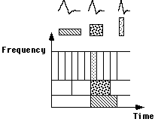
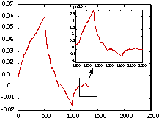
WaveCluster: Clustering by Wavelet Analysis (1998)
Sheikholeslami, Chatterjee, and Zhang (VLDB’98)
A multi-resolution clustering approach which applies wavelet transform to the feature space; both grid-based and density-based
Wavelet transform: A signal processing technique that decomposes a signal into different frequency sub-band
  Data are transformed to preserve relative distance between objects at different levels of resolution
  Allows natural clusters to become more distinguishable
103
Notes:
103

Slide 104
The WaveCluster Algorithm
How to apply wavelet transform to find clusters
  Summarizes the data by imposing a multidimensional grid structure onto data space
  These multidimensional spatial data objects are represented in a n-dimensional feature space
  Apply wavelet transform on feature space to find the dense regions in the feature space
  Apply wavelet transform multiple times which result in clusters at different scales from fine to coarse
Major features:
  Complexity O(N)
  Detect arbitrary shaped clusters at different scales
  Not sensitive to noise, not sensitive to input order
  Only applicable to low dimensional data
104
Notes:
104

Slide 105
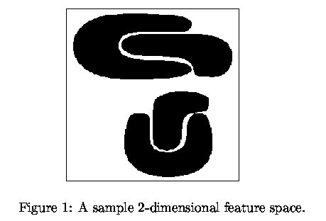
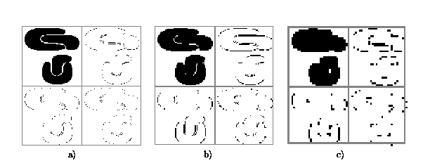
Quantization
& Transformation
Quantize data into m-D grid structure, then wavelet transform
  a) scale 1: high resolution
  b) scale 2: medium resolution
  c) scale 3: low resolution
105
Notes:
105

Slide 106
Outlier Analysis

Slide 107
Outlier Analysis
Outlier and Outlier Analysis
Outlier Detection Methods
Statistical Approaches
Proximity-Base Approaches
Clustering-Base Approaches
Classification Approaches
Mining Contextual and Collective Outliers
Outlier Detection in High Dimensional Data
Summary

Slide 108
What Are Outliers?
Outlier: A data object that deviates significantly from the normal objects as if it were generated by a different mechanism
  Ex.: Unusual credit card purchase, sports: Michael Jordon, Wayne Gretzky, ...
Outliers are different from the noise data
  Noise is random error or variance in a measured variable
  Noise should be removed before outlier detection
Outliers are interesting: It violates the mechanism that generates the normal data
Outlier detection vs. novelty detection: early stage, outlier; but later merged into the model
Applications:
  Credit card fraud detection
  Telecom fraud detection
  Customer segmentation
  Medical analysis

Slide 109
Types of Outliers (I)
Three kinds: global, contextual and collective outliers
Global outlier (or point anomaly)
  Object is O_{g} if it significantly deviates from the rest of the data set
  Ex. Intrusion detection in computer networks
  Issue: Find an appropriate measurement of deviation
Contextual outlier (or conditional outlier)
  Object is O_{c} if it deviates significantly based on a selected context
  Ex. 80º F in Urbana: outlier? (depending on summer or winter?)
  Attributes of data objects should be divided into two groups
    Contextual attributes: defines the context, e.g., time & location
    Behavioral attributes: characteristics of the object, used in outlier evaluation, e.g., temperature
  Can be viewed as a generalization of local outliers—whose density significantly deviates from its local area
  Issue: How to define or formulate meaningful context?
Global Outlier
109

Slide 110
Types of Outliers (II)
Collective Outliers
  A subset of data objects collectively deviate significantly from the whole data set, even if the individual data objects may not be outliers
  Applications: E.g., intrusion detection:
    When a number of computers keep sending denial-of-service packages to each other
Collective Outlier
  Detection of collective outliers
    Consider not only behavior of individual objects, but also that of groups of objects
    Need to have the background knowledge on the relationship among data objects, such as a distance or similarity measure on objects.
A data set may have multiple types of outlier
One object may belong to more than one type of outlier
110

Slide 111
Challenges of Outlier Detection
Modeling normal objects and outliers properly
  Hard to enumerate all possible normal behaviors in an application
  The border between normal and outlier objects is often a gray area
Application-specific outlier detection
  Choice of distance measure among objects and the model of relationship among objects are often application-dependent
  E.g., clinic data: a small deviation could be an outlier; while in marketing analysis, larger fluctuations
Handling noise in outlier detection
  Noise may distort the normal objects and blur the distinction between normal objects and outliers. It may help hide outliers and reduce the effectiveness of outlier detection
Understandability
  Understand why these are outliers: Justification of the detection
  Specify the degree of an outlier: the unlikelihood of the object being generated by a normal mechanism
111

Slide 112
. Outlier Analysis
Outlier and Outlier Analysis
Outlier Detection Methods
Statistical Approaches
Proximity-Base Approaches
Clustering-Base Approaches
Classification Approaches
Mining Contextual and Collective Outliers
Outlier Detection in High Dimensional Data
Summary
112
Notes:
112

Slide 113
Outlier Detection I: Supervised Methods
Two ways to categorize outlier detection methods:
  Based on whether user-labeled examples of outliers can be obtained:
    Supervised, semi-supervised vs. unsupervised methods
  Based on assumptions about normal data and outliers:
    Statistical, proximity-based, and clustering-based methods
Outlier Detection I: Supervised Methods
  Modeling outlier detection as a classification problem
    Samples examined by domain experts used for training & testing
  Methods for Learning a classifier for outlier detection effectively:
    Model normal objects & report those not matching the model as outliers, or
    Model outliers and treat those not matching the model as normal
  Challenges
    Imbalanced classes, i.e., outliers are rare: Boost the outlier class and make up some artificial outliers
    Catch as many outliers as possible, i.e., recall is more important than accuracy (i.e., not mislabeling normal objects as outliers)
113

Slide 114
Outlier Detection II: Unsupervised Methods
Assume the normal objects are somewhat ``clustered'‘ into multiple groups, each having some distinct features
An outlier is expected to be far away from any groups of normal objects
Weakness: Cannot detect collective outlier effectively
  Normal objects may not share any strong patterns, but the collective outliers may share high similarity in a small area
Ex. In some intrusion or virus detection, normal activities are diverse
  Unsupervised methods may have a high false positive rate but still miss many real outliers.
  Supervised methods can be more effective, e.g., identify attacking some key resources
Many clustering methods can be adapted for unsupervised methods
  Find clusters, then outliers: not belonging to any cluster
  Problem 1: Hard to distinguish noise from outliers
  Problem 2: Costly since first clustering: but far less outliers than normal objects
    Newer methods: tackle outliers directly
114

Slide 115
Outlier Detection III: Semi-Supervised Methods
Situation: In many applications, the number of labeled data is often small: Labels could be on outliers only, normal objects only, or both
Semi-supervised outlier detection: Regarded as applications of semi-supervised learning
If some labeled normal objects are available
  Use the labeled examples and the proximate unlabeled objects to train a model for normal objects
  Those not fitting the model of normal objects are detected as outliers
If only some labeled outliers are available, a small number of labeled outliers many not cover the possible outliers well
  To improve the quality of outlier detection, one can get help from models for normal objects learned from unsupervised methods
115

Slide 116
Outlier Detection (1): Statistical Methods
Statistical methods (also known as model-based methods) assume that the normal data follow some statistical model (a stochastic model)
  The data not following the model are outliers.
Example (right figure): First use Gaussian distribution to model the normal data
  For each object y in region R, estimate g_{D}(y), the probability of y fits the Gaussian distribution
  If g_{D}(y) is very low, y is unlikely generated by the Gaussian model, thus an outlier
Effectiveness of statistical methods: highly depends on whether the assumption of statistical model holds in the real data
There are rich alternatives to use various statistical models
  E.g., parametric vs. non-parametric
116

Slide 117
Outlier Detection (2): Proximity-Based Methods
An object is an outlier if the nearest neighbors of the object are far away, i.e., the proximity of the object is significantly deviates from the proximity of most of the other objects in the same data set
Example (right figure): Model the proximity of an object using its 3 nearest neighbors
  Objects in region R are substantially different from other objects in the data set.
  Thus the objects in R are outliers
The effectiveness of proximity-based methods highly relies on the proximity measure.
In some applications, proximity or distance measures cannot be obtained easily.
Often have a difficulty in finding a group of outliers which stay close to each other
Two major types of proximity-based outlier detection
  Distance-based vs. density-based
117

Slide 118
Outlier Detection (3): Clustering-Based Methods
Normal data belong to large and dense clusters, whereas outliers belong to small or sparse clusters, or do not belong to any clusters
Example (right figure): two clusters
  All points not in R form a large cluster
  The two points in R form a tiny cluster, thus are outliers
Since there are many clustering methods, there are many clustering-based outlier detection methods as well
Clustering is expensive: straightforward adaption of a clustering method for outlier detection can be costly and does not scale up well for large data sets
118

Slide 119
Outlier Analysis
Outlier and Outlier Analysis
Outlier Detection Methods
Statistical Approaches
Proximity-Base Approaches
Clustering-Base Approaches
Classification Approaches
Mining Contextual and Collective Outliers
Outlier Detection in High Dimensional Data
Summary
119
Notes:
119

Slide 120
Statistical Approaches
Statistical approaches assume that the objects in a data set are generated by a stochastic process (a generative model)
Idea: learn a generative model fitting the given data set, and then identify the objects in low probability regions of the model as outliers
Methods are divided into two categories: parametric vs. non-parametric
Parametric method
  Assumes that the normal data is generated by a parametric distribution with parameter θ
  The probability density function of the parametric distribution f(x, θ) gives the probability that object x is generated by the distribution
  The smaller this value, the more likely x is an outlier
Non-parametric method
  Not assume an a-priori statistical model and determine the model from the input data
  Not completely parameter free but consider the number and nature of the parameters are flexible and not fixed in advance
  Examples: histogram and kernel density estimation
120

Slide 121


Parametric Methods I: Detection Univariate Outliers Based on Normal Distribution
Univariate data: A data set involving only one attribute or variable
Often assume that data are generated from a normal distribution, learn the parameters from the input data, and identify the points with low probability as outliers
Ex: Avg. temp.: {24.0, 28.9, 28.9, 29.0, 29.1, 29.1, 29.2, 29.2, 29.3, 29.4}
  Use the maximum likelihood method to estimate μ and σ
  Taking derivatives with respect to μ and σ², we derive the following maximum likelihood estimates
  For the above data with n = 10, we have
  Then (24 – 28.61) /1.51 = – 3.04 < –3, 24 is an outlier since
121

Slide 122

Parametric Methods I: The Grubb’s Test
Univariate outlier detection: The Grubb's test (maximum normed residual test) ─ another statistical method under normal distribution
  For each object x in a data set, compute its z-score: x is an outlier if
    where is the value taken by a t-distribution at a significance level of α/(2N), and N is the # of objects in the data set
122

Slide 123

Parametric Methods II: Detection of Multivariate Outliers
Multivariate data: A data set involving two or more attributes or variables
Transform the multivariate outlier detection task into a univariate outlier detection problem
Method 1. Compute Mahalaobis distance
  Let ō be the mean vector for a multivariate data set. Mahalaobis distance for an object o to ō is MDist(o, ō) = (o – ō )^{T} S ^{–1}(o – ō) where S is the covariance matrix
  Use the Grubb's test on this measure to detect outliers
Method 2. Use χ² –statistic:
  where E_{i} is the mean of the i-dimension among all objects, and n is the dimensionality
  If χ² –statistic is large, then object o_{i} is an outlier
123

Slide 124
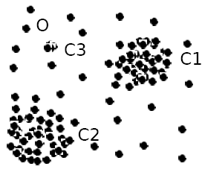
Parametric Methods III: Using Mixture of Parametric Distributions
Assuming data generated by a normal distribution could be sometimes overly simplified
Example (right figure): The objects between the two clusters cannot be captured as outliers since they are close to the estimated mean
To overcome this problem, assume the normal data is generated by two normal distributions. For any object o in the data set, the probability that o is generated by the mixture of the two distributions is given by
  where f_{θ1} and f_{θ2} are the probability density functions of θ₁ and θ₂
Then use EM algorithm to learn the parameters μ₁, σ₁, μ₂, σ₂ from data
An object o is an outlier if it does not belong to any cluster
124

Slide 125
Non-Parametric Methods: Detection Using Histogram
The model of normal data is learned from the input data without any a priori structure.
Often makes fewer assumptions about the data, and thus can be applicable in more scenarios
Outlier detection using histogram:
  Figure shows the histogram of purchase amounts in transactions
  A transaction in the amount of $7,500 is an outlier, since only 0.2% transactions have an amount higher than $5,000
Problem: Hard to choose an appropriate bin size for histogram
  Too small bin size → normal objects in empty/rare bins, false positive
  Too big bin size → outliers in some frequent bins, false negative
Solution: Adopt kernel density estimation to estimate the probability density distribution of the data. If the estimated density function is high, the object is likely normal. Otherwise, it is likely an outlier.
125

Slide 126
Chapter 12. Outlier Analysis
Outlier and Outlier Analysis
Outlier Detection Methods
Statistical Approaches
Proximity-Base Approaches
Clustering-Base Approaches
Classification Approaches
Mining Contextual and Collective Outliers
Outlier Detection in High Dimensional Data
Summary
126
Notes:
126

Slide 127
Proximity-Based Approaches: Distance-Based vs. Density-Based Outlier Detection
Intuition: Objects that are far away from the others are outliers
Assumption of proximity-based approach: The proximity of an outlier deviates significantly from that of most of the others in the data set
Two types of proximity-based outlier detection methods
  Distance-based outlier detection: An object o is an outlier if its neighborhood does not have enough other points
  Density-based outlier detection: An object o is an outlier if its density is relatively much lower than that of its neighbors
127

Slide 128
Distance-Based Outlier Detection
For each object o, examine the # of other objects in the r-neighborhood of o, where r is a user-specified distance threshold
An object o is an outlier if most (taking π as a fraction threshold) of the objects in D are far away from o, i.e., not in the r-neighborhood of o
An object o is a DB(r, π) outlier if
Equivalently, one can check the distance between o and its k-th nearest neighbor o_{k}, where . o is an outlier if dist(o, o_{k}) > r
Efficient computation: Nested loop algorithm
  For any object o_{i}, calculate its distance from other objects, and count the # of other objects in the r-neighborhood.
  If π∙n other objects are within r distance, terminate the inner loop
  Otherwise, o_{i} is a DB(r, π) outlier
Efficiency: Actually CPU time is not O(n²) but linear to the data set size since for most non-outlier objects, the inner loop terminates early
128

Slide 129
Distance-Based Outlier Detection: A Grid-Based Method
Why efficiency is still a concern? When the complete set of objects cannot be held into main memory, cost I/O swapping
The major cost: (1) each object tests against the whole data set, why not only its close neighbor? (2) check objects one by one, why not group by group?
Grid-based method (CELL): Data space is partitioned into a multi-D grid. Each cell is a hyper cube with diagonal length r/2
Pruning using the level-1 & level 2 cell properties:
  For any possible point x in cell C and any possible point y in a level-1 cell, dist(x,y) ≤ r
  For any possible point x in cell C and any point y such that dist(x,y) ≥ r, y is in a level-2 cell
Thus we only need to check the objects that cannot be pruned, and even for such an object o, only need to compute the distance between o and the objects in the level-2 cells (since beyond level-2, the distance from o is more than r)
129

Slide 130
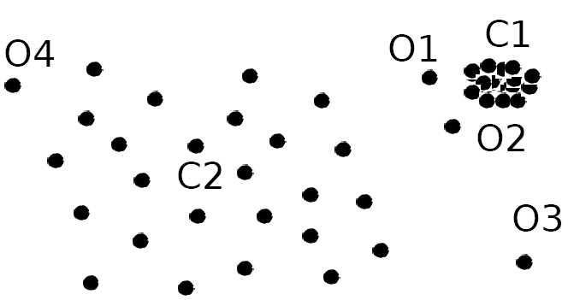
Density-Based Outlier Detection
Local outliers: Outliers comparing to their local neighborhoods, instead of the global data distribution
In Fig., o₁ and o2 are local outliers to C₁, o₃ is a global outlier, but o₄ is not an outlier. However, proximity-based clustering cannot find o₁ and o₂ are outlier (e.g., comparing with O₄).
Intuition (density-based outlier detection): The density around an outlier object is significantly different from the density around its neighbors
Method: Use the relative density of an object against its neighbors as the indicator of the degree of the object being outliers
k-distance of an object o, dist_{k}(o): distance between o and its k-th NN
k-distance neighborhood of o, N_{k}(o) = {o’| o’ in D, dist(o, o’) ≤ dist_{k}(o)}
  N_{k}(o) could be bigger than k since multiple objects may have identical distance to o
130

Slide 131
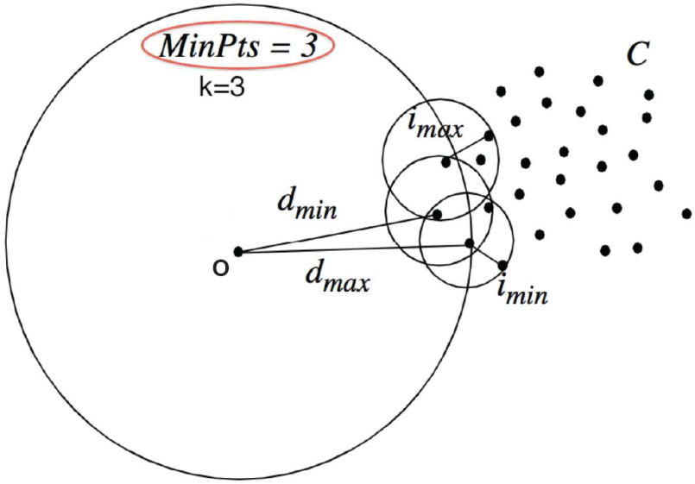
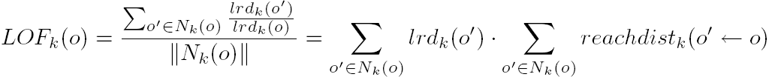
Local Outlier Factor: LOF
Reachability distance from o’ to o:
  where k is a user-specified parameter
Local reachability density of o:
LOF (Local outlier factor) of an object o is the average of the ratio of local reachability of o and those of o’s k-nearest neighbors
The lower the local reachability density of o, and the higher the local reachability density of the kNN of o, the higher LOF
This captures a local outlier whose local density is relatively low comparing to the local densities of its kNN
131

Slide 132
Chapter 12. Outlier Analysis
Outlier and Outlier Analysis
Outlier Detection Methods
Statistical Approaches
Proximity-Base Approaches
Clustering-Base Approaches
Classification Approaches
Mining Contextual and Collective Outliers
Outlier Detection in High Dimensional Data
Summary
132
Notes:
132

Slide 133
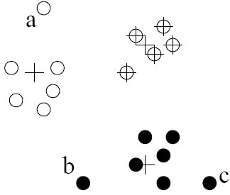
Clustering-Based Outlier Detection (1 & 2):
Not belong to any cluster, or far from the closest one
An object is an outlier if (1) it does not belong to any cluster, (2) there is a large distance between the object and its closest cluster , or (3) it belongs to a small or sparse cluster
Case I: Not belong to any cluster
  Identify animals not part of a flock: Using a density-based clustering method such as DBSCAN
Case 2: Far from its closest cluster
  Using k-means, partition data points of into clusters
  For each object o, assign an outlier score based on its distance from its closest center
    If dist(o, c_{o})/avg_dist(c_{o}) is large, likely an outlier
Ex. Intrusion detection: Consider the similarity between data points and the clusters in a training data set
  Use a training set to find patterns of “normal” data, e.g., frequent itemsets in each segment, and cluster similar connections into groups
  Compare new data points with the clusters mined—Outliers are possible attacks
133

Slide 134
Clustering-Based Outlier Detection (3):
Detecting Outliers in Small Clusters
FindCBLOF: Detect outliers in small clusters
  Find clusters, and sort them in decreasing size
  To each data point, assign a cluster-based local outlier factor (CBLOF):
  If obj p belongs to a large cluster, CBLOF = cluster_size X similarity between p and cluster
  If p belongs to a small one, CBLOF = cluster size X similarity betw. p and the closest large cluster
Ex. In the figure, o is outlier since its closest large cluster is C₁, but the similarity between o and C₁ is small. For any point in C₃, its closest large cluster is C₂ but its similarity from C₂ is low, plus |C₃| = 3 is small
134

Slide 135
Clustering-Based Method: Strength and Weakness
Strength
  Detect outliers without requiring any labeled data
  Work for many types of data
  Clusters can be regarded as summaries of the data
  Once the cluster are obtained, need only compare any object against the clusters to determine whether it is an outlier (fast)
Weakness
  Effectiveness depends highly on the clustering method used—they may not be optimized for outlier detection
  High computational cost: Need to first find clusters
  A method to reduce the cost: Fixed-width clustering
    A point is assigned to a cluster if the center of the cluster is within a pre-defined distance threshold from the point
    If a point cannot be assigned to any existing cluster, a new cluster is created and the distance threshold may be learned from the training data under certain conditions

Slide 136
Chapter 12. Outlier Analysis
Outlier and Outlier Analysis
Outlier Detection Methods
Statistical Approaches
Proximity-Base Approaches
Clustering-Base Approaches
Classification Approaches
Mining Contextual and Collective Outliers
Outlier Detection in High Dimensional Data
Summary
136
Notes:
136

Slide 137
Classification-Based Method I: One-Class Model
Idea: Train a classification model that can distinguish “normal” data from outliers
A brute-force approach: Consider a training set that contains samples labeled as “normal” and others labeled as “outlier”
  But, the training set is typically heavily biased: # of “normal” samples likely far exceeds # of outlier samples
  Cannot detect unseen anomaly
One-class model: A classifier is built to describe only the normal class.
  Learn the decision boundary of the normal class using classification methods such as SVM
  Any samples that do not belong to the normal class (not within the decision boundary) are declared as outliers
  Adv: can detect new outliers that may not appear close to any outlier objects in the training set
  Extension: Normal objects may belong to multiple classes
137

Slide 138
Classification-Based Method II: Semi-Supervised Learning
Semi-supervised learning: Combining classification-based and clustering-based methods
Method
  Using a clustering-based approach, find a large cluster, C, and a small cluster, C₁
  Since some objects in C carry the label “normal”, treat all objects in C as normal
  Use the one-class model of this cluster to identify normal objects in outlier detection
  Since some objects in cluster C₁ carry the label “outlier”, declare all objects in C₁ as outliers
  Any object that does not fall into the model for C (such as a) is considered an outlier as well
Comments on classification-based outlier detection methods
  Strength: Outlier detection is fast
  Bottleneck: Quality heavily depends on the availability and quality of the training set, but often difficult to obtain representative and high-quality training data
138

Slide 139
Outlier Analysis
Outlier and Outlier Analysis
Outlier Detection Methods
Statistical Approaches
Proximity-Base Approaches
Clustering-Base Approaches
Classification Approaches
Mining Contextual and Collective Outliers
Outlier Detection in High Dimensional Data
Summary
139
Notes:
139

Slide 140
Mining Contextual Outliers I: Transform into
Conventional Outlier Detection
If the contexts can be clearly identified, transform it to conventional outlier detection
  Identify the context of the object using the contextual attributes
  Calculate the outlier score for the object in the context using a conventional outlier detection method
Ex. Detect outlier customers in the context of customer groups
  Contextual attributes: age group, postal code
  Behavioral attributes: # of trans/yr, annual total trans. amount
Steps: (1) locate c’s context, (2) compare c with the other customers in the same group, and (3) use a conventional outlier detection method
If the context contains very few customers, generalize contexts
  Ex. Learn a mixture model U on the contextual attributes, and another mixture model V of the data on the behavior attributes
  Learn a mapping p(V_{i}|U_{j}): the probability that a data object o belonging to cluster U_{j} on the contextual attributes is generated by cluster Vi on the behavior attributes
  Outlier score:
140

Slide 141
Mining Contextual Outliers II: Modeling Normal Behavior with Respect to Contexts
In some applications, one cannot clearly partition the data into contexts
  Ex. if a customer suddenly purchased a product that is unrelated to those she recently browsed, it is unclear how many products browsed earlier should be considered as the context
Model the “normal” behavior with respect to contexts
  Using a training data set, train a model that predicts the expected behavior attribute values with respect to the contextual attribute values
  An object is a contextual outlier if its behavior attribute values significantly deviate from the values predicted by the model
Using a prediction model that links the contexts and behavior, these methods avoid the explicit identification of specific contexts
Methods: A number of classification and prediction techniques can be used to build such models, such as regression, Markov Models, and Finite State Automaton
141

Slide 142
Mining Collective Outliers I: On the Set of “Structured Objects”
Collective outlier if objects as a group deviate significantly from the entire data
Need to examine the structure of the data set, i.e, the relationships between multiple data objects
Each of these structures is inherent to its respective type of data
  For temporal data (such as time series and sequences), we explore the structures formed by time, which occur in segments of the time series or subsequences
  For spatial data, explore local areas
  For graph and network data, we explore subgraphs
Difference from the contextual outlier detection: the structures are often not explicitly defined, and have to be discovered as part of the outlier detection process.
Collective outlier detection methods: two categories
  Reduce the problem to conventional outlier detection
    Identify structure units, treat each structure unit (e.g., subsequence, time series segment, local area, or subgraph) as a data object, and extract features
    Then outlier detection on the set of “structured objects” constructed as such using the extracted features
142

Slide 143
Mining Collective Outliers II: Direct Modeling of the Expected Behavior of Structure Units
Models the expected behavior of structure units directly
Ex. 1. Detect collective outliers in online social network of customers
  Treat each possible subgraph of the network as a structure unit
  Collective outlier: An outlier subgraph in the social network
    Small subgraphs that are of very low frequency
    Large subgraphs that are surprisingly frequent
Ex. 2. Detect collective outliers in temporal sequences
  Learn a Markov model from the sequences
  A subsequence can then be declared as a collective outlier if it significantly deviates from the model
Collective outlier detection is subtle due to the challenge of exploring the structures in data
  The exploration typically uses heuristics, and thus may be application dependent
  The computational cost is often high due to the sophisticated mining process
143

Slide 144
Chapter 12. Outlier Analysis
Outlier and Outlier Analysis
Outlier Detection Methods
Statistical Approaches
Proximity-Base Approaches
Clustering-Base Approaches
Classification Approaches
Mining Contextual and Collective Outliers
Outlier Detection in High Dimensional Data
Summary
144
Notes:
144

Slide 145
Challenges for Outlier Detection in High-Dimensional Data
Interpretation of outliers
  Detecting outliers without saying why they are outliers is not very useful in high-D due to many features (or dimensions) are involved in a high-dimensional data set
  E.g., which subspaces that manifest the outliers or an assessment regarding the “outlier-ness” of the objects
Data sparsity
  Data in high-D spaces are often sparse
  The distance between objects becomes heavily dominated by noise as the dimensionality increases
Data subspaces
  Adaptive to the subspaces signifying the outliers
  Capturing the local behavior of data
Scalable with respect to dimensionality
  # of subspaces increases exponentially
145

Slide 146
Approach I: Extending Conventional Outlier Detection
Method 1: Detect outliers in the full space, e.g., HilOut Algorithm
  Find distance-based outliers, but use the ranks of distance instead of the absolute distance in outlier detection
  For each object o, find its k-nearest neighbors: nn₁(o), . . . , nn_{k}(o)
  The weight of object o:
  All objects are ranked in weight-descending order
  Top-l objects in weight are output as outliers (l: user-specified parm)
  Employ space-filling curves for approximation: scalable in both time and space w.r.t. data size and dimensionality
Method 2: Dimensionality reduction
  Works only when in lower-dimensionality, normal instances can still be distinguished from outliers
  PCA: Heuristically, the principal components with low variance are preferred because, on such dimensions, normal objects are likely close to each other and outliers often deviate from the majority
146

Slide 147

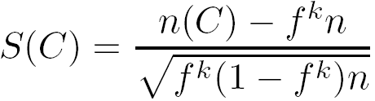
Approach II: Finding Outliers in Subspaces
Extending conventional outlier detection: Hard for outlier interpretation
Find outliers in much lower dimensional subspaces: easy to interpret why and to what extent the object is an outlier
  E.g., find outlier customers in certain subspace: average transaction amount >> avg. and purchase frequency << avg.
Ex. A grid-based subspace outlier detection method
  Project data onto various subspaces to find an area whose density is much lower than average
  Discretize the data into a grid with φ equi-depth (why?) regions
  Search for regions that are significantly sparse
    Consider a k-d cube: k ranges on k dimensions, with n objects
    If objects are independently distributed, the expected number of objects falling into a k-dimensional region is (1/ φ)^{k}n = f^{k}n,the standard deviation is
    The sparsity coefficient of cube C:
    If S(C) < 0, C contains less objects than expected
    The more negative, the sparser C is and the more likely the objects in C are outliers in the subspace
147

Slide 148
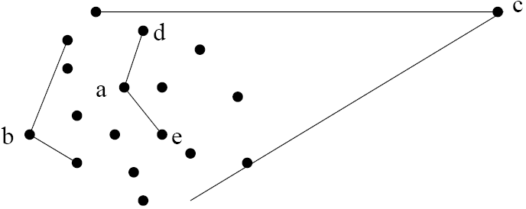
Approach III: Modeling High-Dimensional Outliers
Develop new models for high-dimensional outliers directly
Avoid proximity measures and adopt new heuristics that do not deteriorate in high-dimensional data
A set of points form a cluster except c (outlier)
Ex. Angle-based outliers: Kriegel, Schubert, and Zimek [KSZ08]
For each point o, examine the angle ∆xoy for every pair of points x, y.
  Point in the center (e.g., a), the angles formed differ widely
  An outlier (e.g., c), angle variable is substantially smaller
Use the variance of angles for a point to determine outlier
Combine angles and distance to model outliers
  Use the distance-weighted angle variance as the outlier score
  Angle-based outlier factor (ABOF):
  Efficient approximation computation method is developed
  It can be generalized to handle arbitrary types of data
148

Slide 149
Chapter 12. Outlier Analysis
Outlier and Outlier Analysis
Outlier Detection Methods
Statistical Approaches
Proximity-Base Approaches
Clustering-Base Approaches
Classification Approaches
Mining Contextual and Collective Outliers
Outlier Detection in High Dimensional Data
Summary
149
Notes:
149

Slide 150
Summary
Types of outliers
  global, contextual & collective outliers
Outlier detection
  supervised, semi-supervised, or unsupervised
Statistical (or model-based) approaches
Proximity-base approaches
Clustering-base approaches
Classification approaches
Mining contextual and collective outliers
Outlier detection in high dimensional data
150

Slide 151
References (I)
B. Abraham and G.E.P. Box. Bayesian analysis of some outlier problems in time series. Biometrika, 66:229–248, 1979.
M. Agyemang, K. Barker, and R. Alhajj. A comprehensive survey of numeric and symbolic outlier mining techniques. Intell. Data Anal., 10:521–538, 2006.
F. J. Anscombe and I. Guttman. Rejection of outliers. Technometrics, 2:123–147, 1960.
D. Agarwal. Detecting anomalies in cross-classified streams: a bayesian approach. Knowl. Inf. Syst., 11:29–44, 2006.
F. Angiulli and C. Pizzuti. Outlier mining in large high-dimensional data sets. TKDE, 2005.
C. C. Aggarwal and P. S. Yu. Outlier detection for high dimensional data. SIGMOD’01
R.J. Beckman and R.D. Cook. Outlier...s. Technometrics, 25:119–149, 1983.
I. Ben-Gal. Outlier detection. In Maimon O. and Rockach L. (eds.) Data Mining and Knowledge Discovery Handbook: A Complete Guide for Practitioners and Researchers, Kluwer Academic, 2005.
M. M. Breunig, H.-P. Kriegel, R. Ng, and J. Sander. LOF: Identifying density-based local outliers. SIGMOD’00
D. Barbar´a, Y. Li, J. Couto, J.-L. Lin, and S. Jajodia. Bootstrapping a data mining intrusion detection system. SAC’03
Z. A. Bakar, R. Mohemad, A. Ahmad, and M. M. Deris. A comparative study for outlier detection techniques in data mining. IEEE Conf. on Cybernetics and Intelligent Systems, 2006.
S. D. Bay and M. Schwabacher. Mining distance-based outliers in near linear time with randomization and a simple pruning rule. KDD’03
D. Barbara, N. Wu, and S. Jajodia. Detecting novel network intrusion using bayesian estimators. SDM’01
V. Chandola, A. Banerjee, and V. Kumar. Anomaly detection: A survey. ACM Computing Surveys, 41:1–58, 2009.
D. Dasgupta and N.S. Majumdar. Anomaly detection in multidimensional data using negative selection algorithm. In CEC’02

Slide 152
References (2)
E. Eskin, A. Arnold, M. Prerau, L. Portnoy, and S. Stolfo. A geometric framework for unsupervised anomaly detection: Detecting intrusions in unlabeled data. In Proc. 2002 Int. Conf. of Data Mining for Security Applications, 2002.
E. Eskin. Anomaly detection over noisy data using learned probability distributions. ICML’00
T. Fawcett and F. Provost. Adaptive fraud detection. Data Mining and Knowledge Discovery, 1:291–316, 1997.
V. J. Hodge and J. Austin. A survey of outlier detection methdologies. Artif. Intell. Rev., 22:85–126, 2004.
D. M. Hawkins. Identification of Outliers. Chapman and Hall, London, 1980.
Z. He, X. Xu, and S. Deng. Discovering cluster-based local outliers. Pattern Recogn. Lett., 24, June, 2003.
W. Jin, K. H. Tung, and J. Han. Mining top-n local outliers in large databases. KDD’01
W. Jin, A. K. H. Tung, J. Han, and W. Wang. Ranking outliers using symmetric neighborhood relationship. PAKDD’06
E. Knorr and R. Ng. A unified notion of outliers: Properties and computation. KDD’97
E. Knorr and R. Ng. Algorithms for mining distance-based outliers in large datasets. VLDB’98
E. M. Knorr, R. T. Ng, and V. Tucakov. Distance-based outliers: Algorithms and applications. VLDB J., 8:237–253, 2000.
H.-P. Kriegel, M. Schubert, and A. Zimek. Angle-based outlier detection in high-dimensional data. KDD’08
M. Markou and S. Singh. Novelty detection: A review—part 1: Statistical approaches. Signal Process., 83:2481–2497, 2003.
M. Markou and S. Singh. Novelty detection: A review—part 2: Neural network based approaches. Signal Process., 83:2499–2521, 2003.
C. C. Noble and D. J. Cook. Graph-based anomaly detection. KDD’03

Slide 153
References (3)
S. Papadimitriou, H. Kitagawa, P. B. Gibbons, and C. Faloutsos. Loci: Fast outlier detection using the local correlation integral. ICDE’03
A. Patcha and J.-M. Park. An overview of anomaly detection techniques: Existing solutions and latest technological trends. Comput. Netw., 51, 2007.
X. Song, M. Wu, C. Jermaine, and S. Ranka. Conditional anomaly detection. IEEE Trans. on Knowl. and Data Eng., 19, 2007.
Y. Tao, X. Xiao, and S. Zhou. Mining distance-based outliers from large databases in any metric space. KDD’06
N. Ye and Q. Chen. An anomaly detection technique based on a chi-square statistic for detecting intrusions into information systems. Quality and Reliability Engineering International, 17:105–112, 2001.
B.-K. Yi, N. Sidiropoulos, T. Johnson, H. V. Jagadish, C. Faloutsos, and A. Biliris. Online data mining for co-evolving time sequences. ICDE’00

Slide 154
THANK YOU

